Slide 1

Open Energy Knowledge Gateway
—
Kseniia Sych, Laura Żukowska, Tomasz Jażdżewski,
Paweł Urba, Grzegorz Król
Energieschweiz & VirtusLab Team

Slide 2
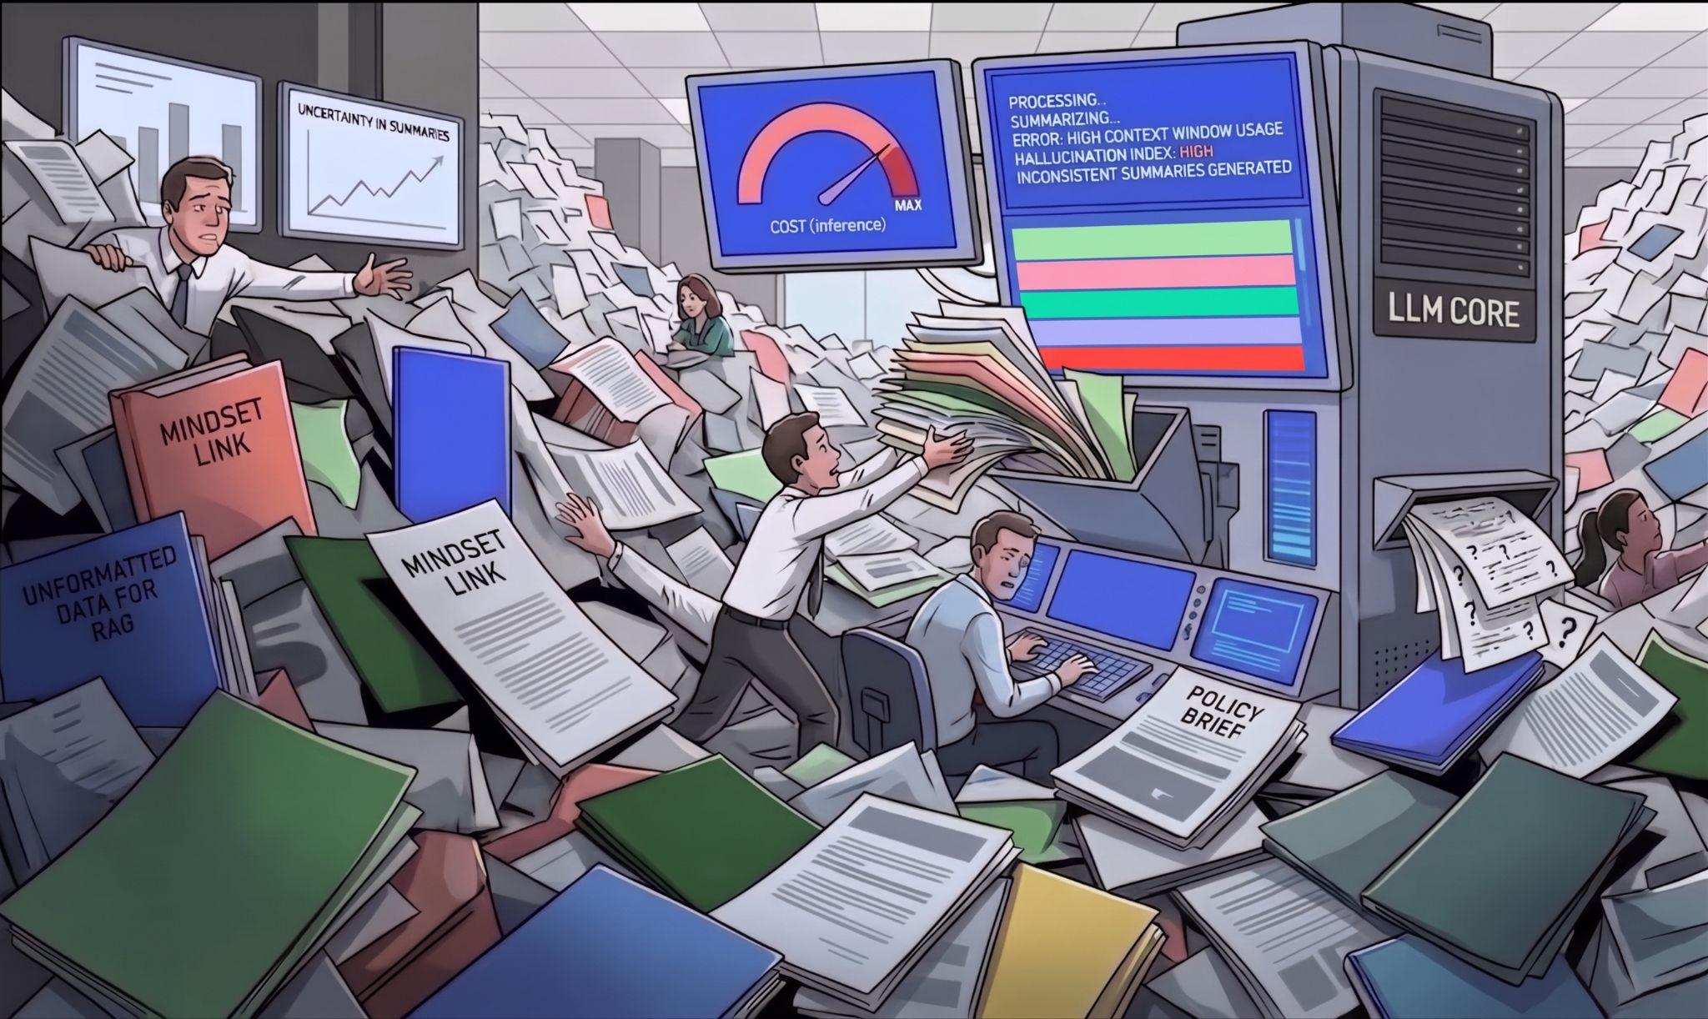


Slide 3
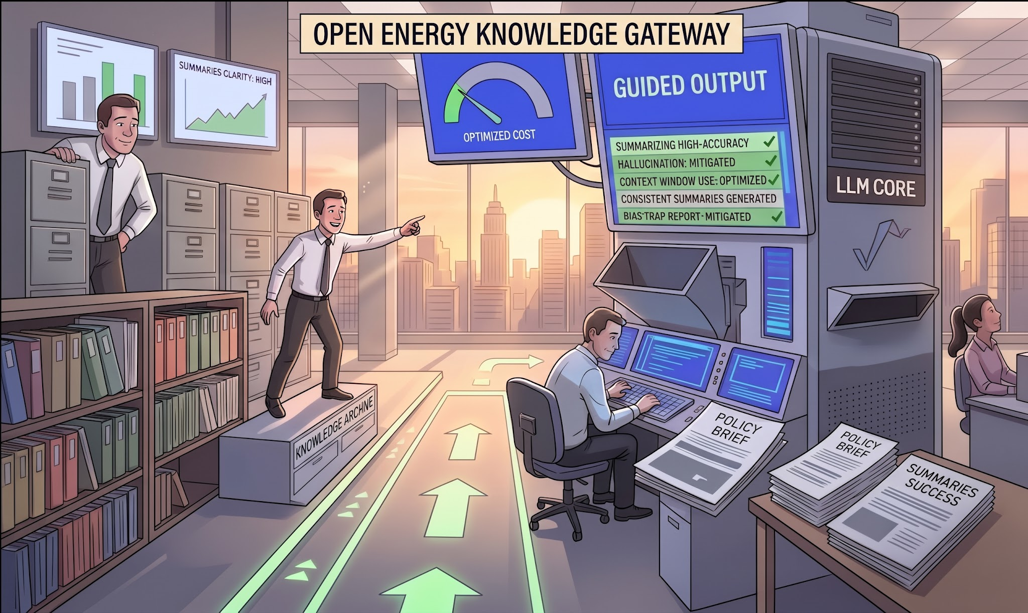

Slide 4
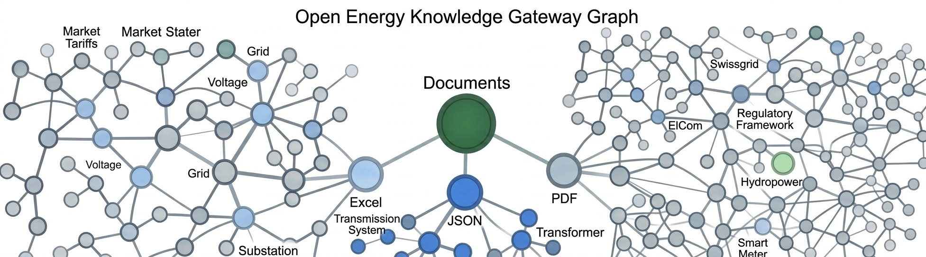

Slide 5
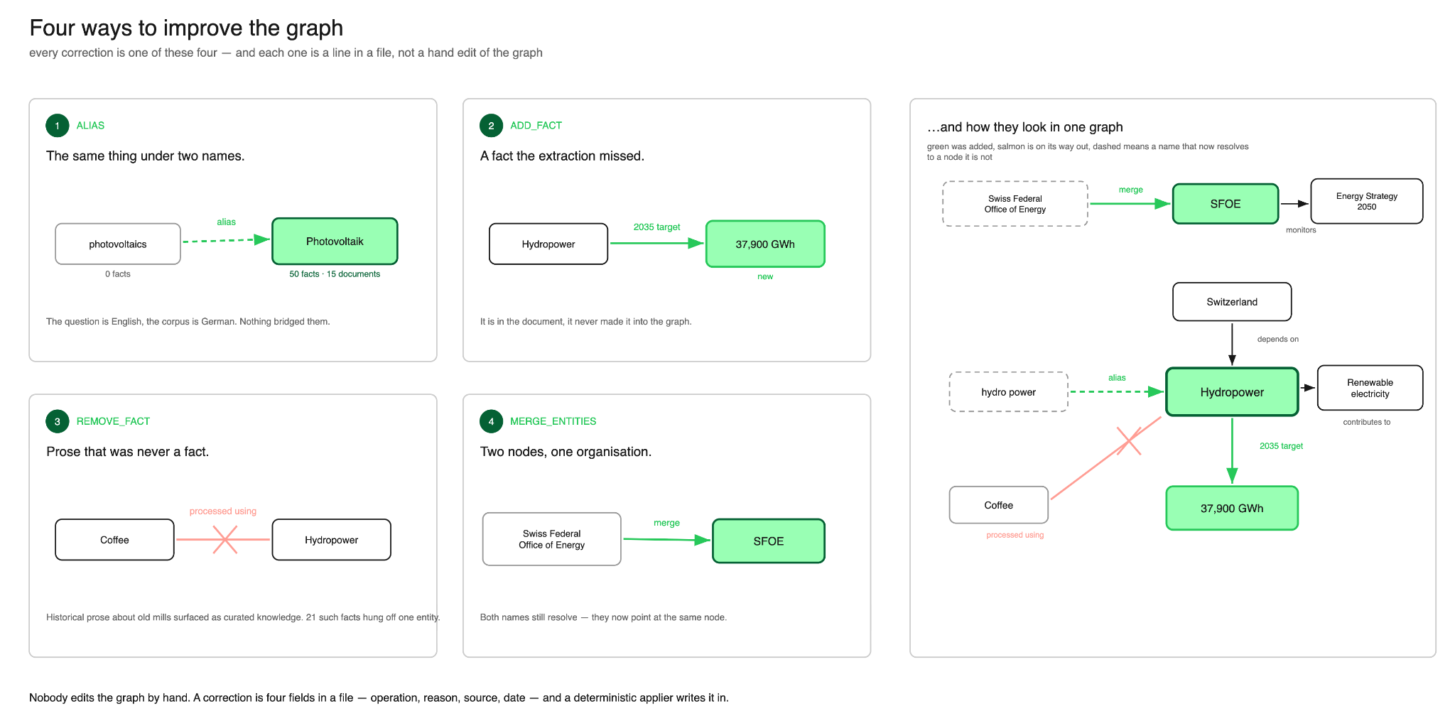

Slide 6
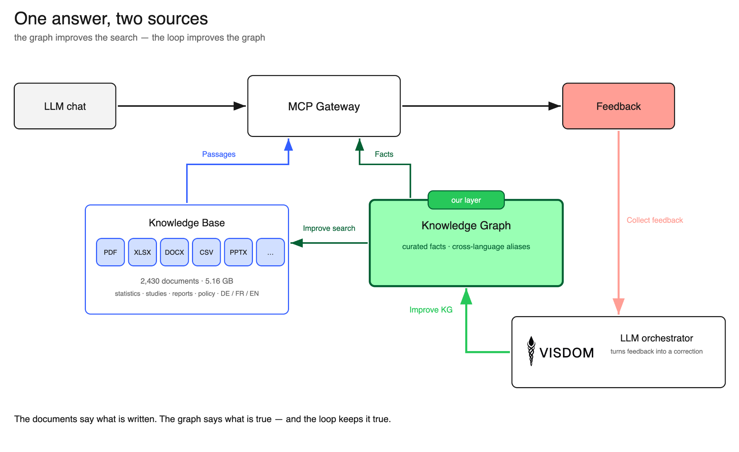

Slide 7

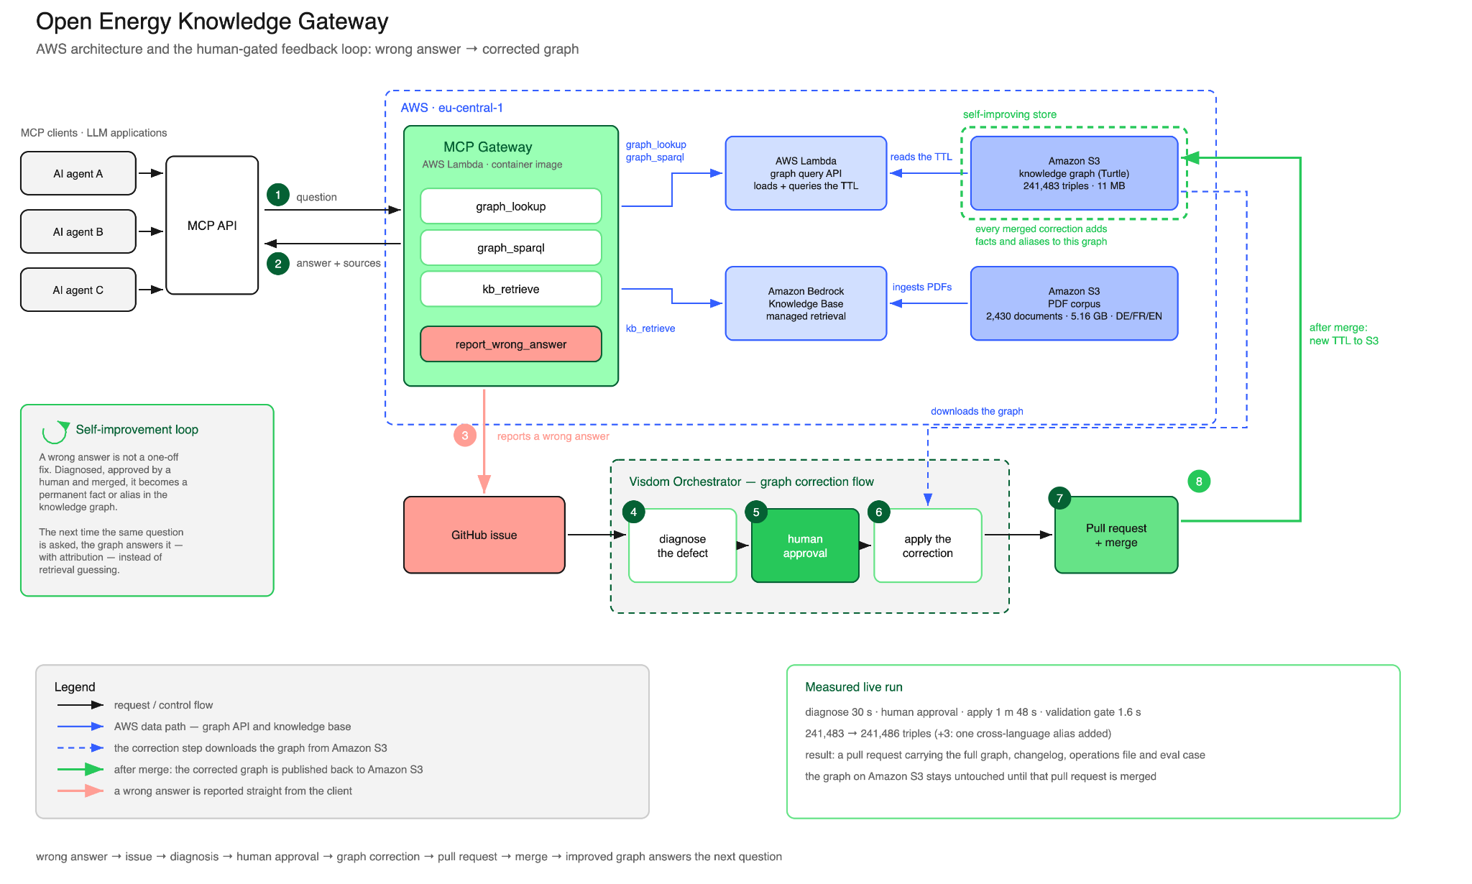



Slide 8

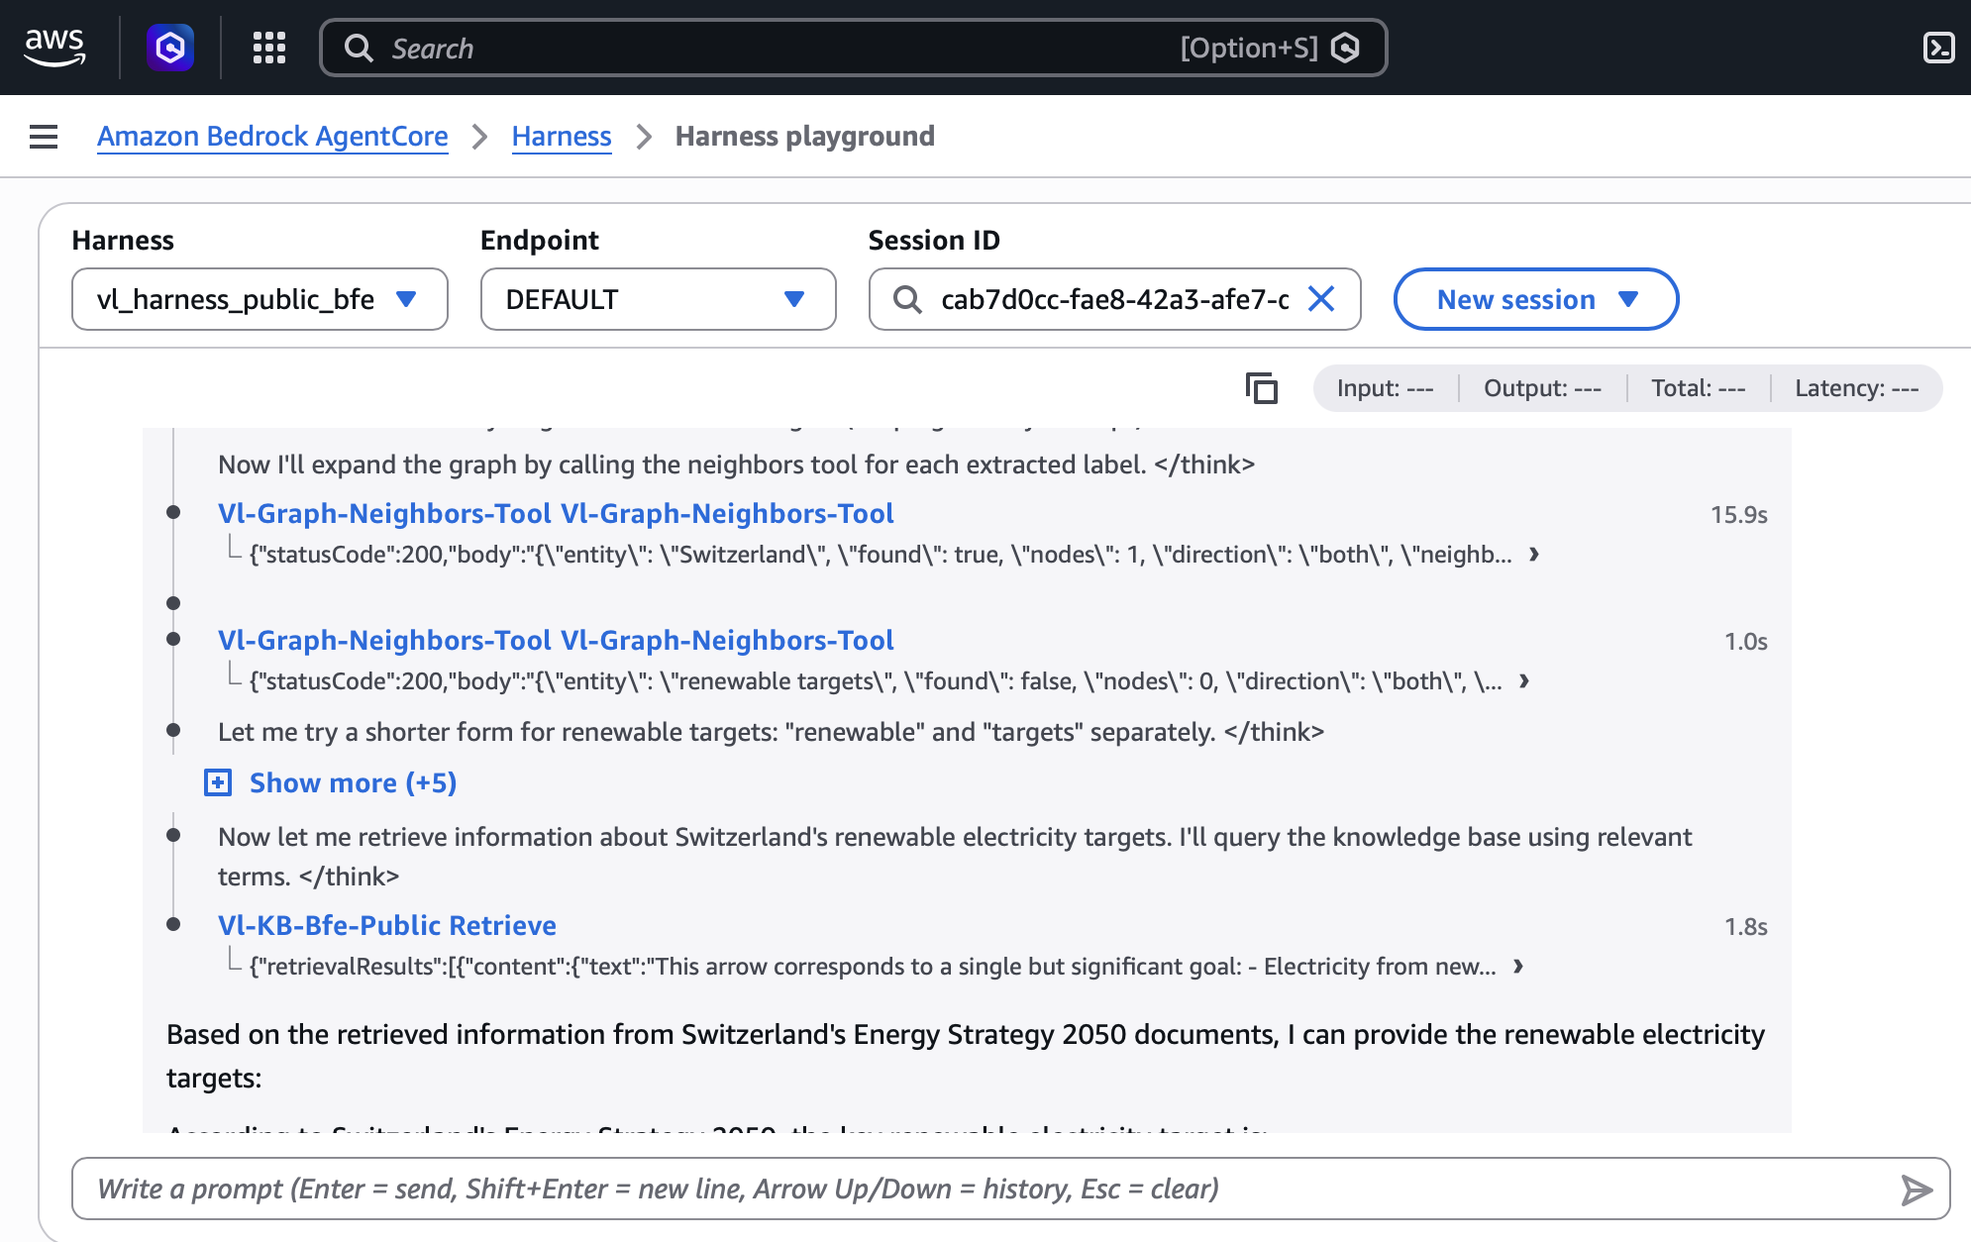
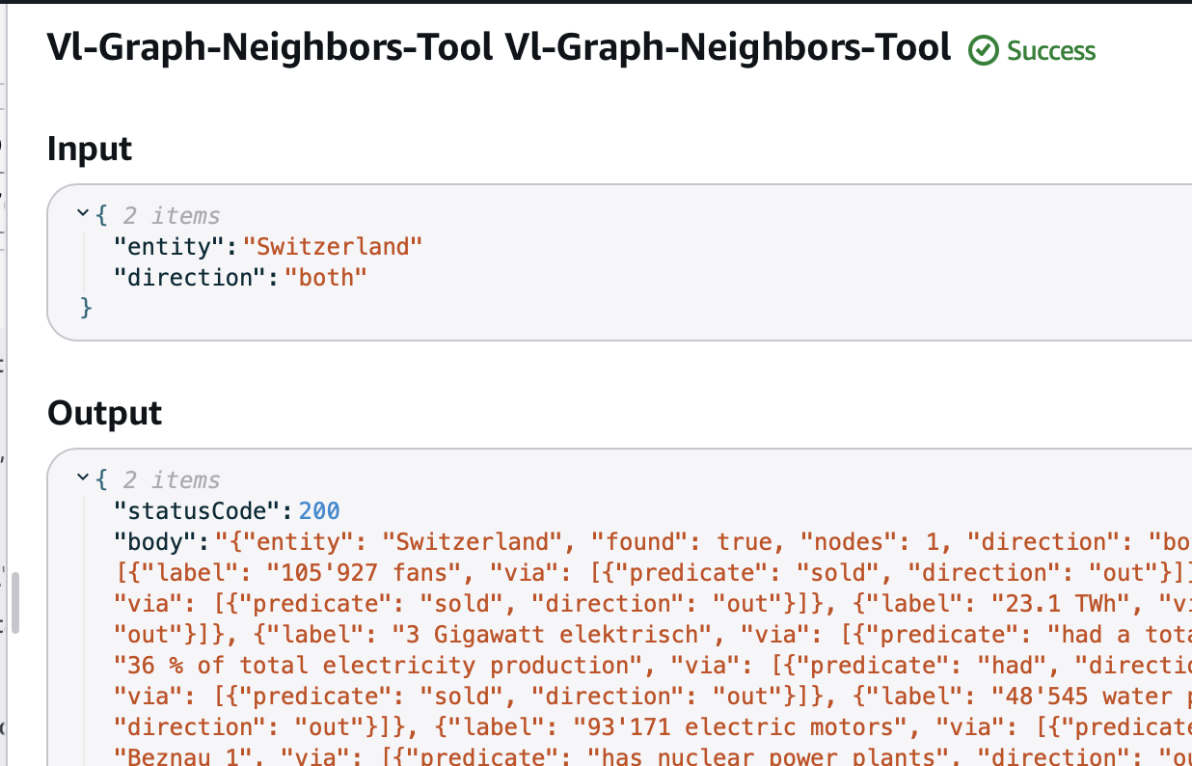
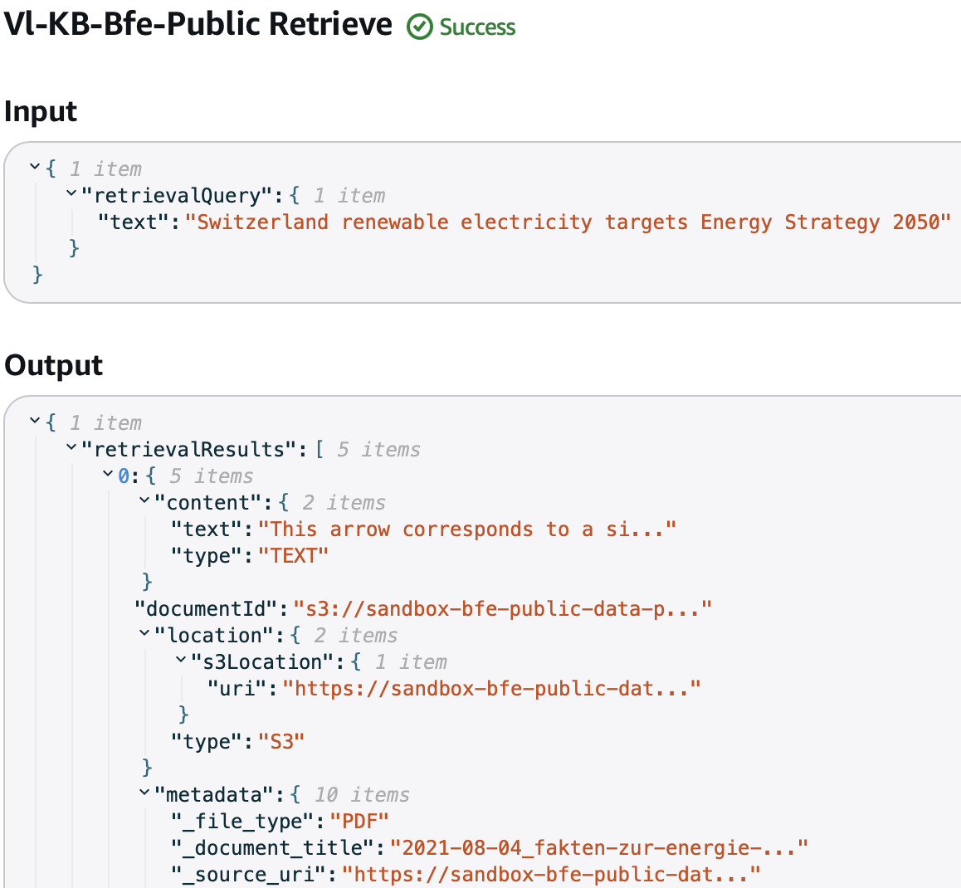
Tool calls in real time
— “What are Switzerland's renewable electricity targets?”
Graph lookup tool call
Retrieve tool call

Slide 9
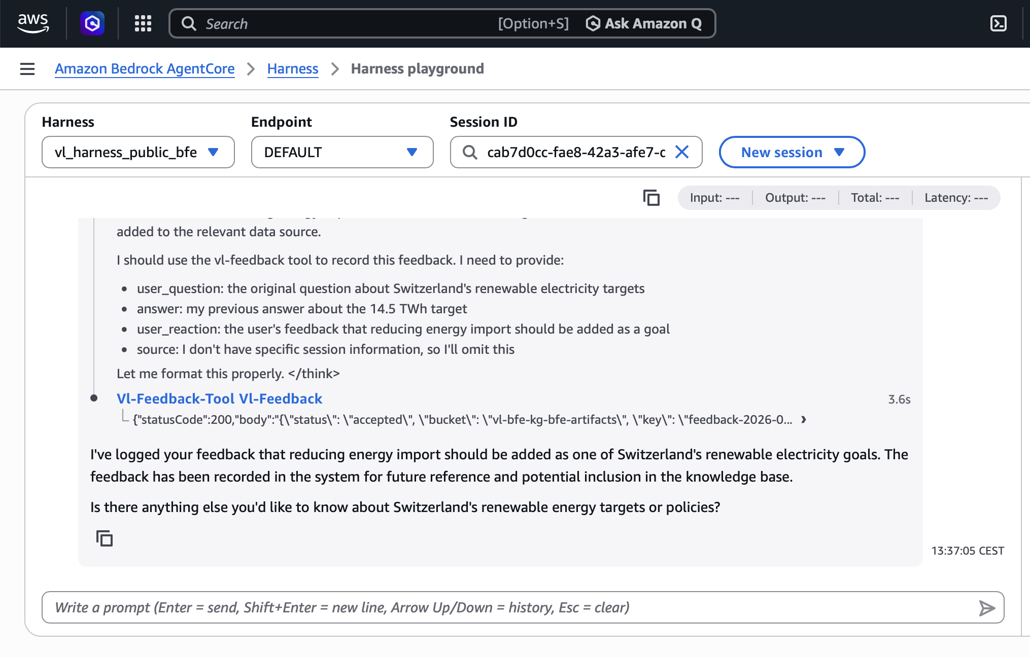
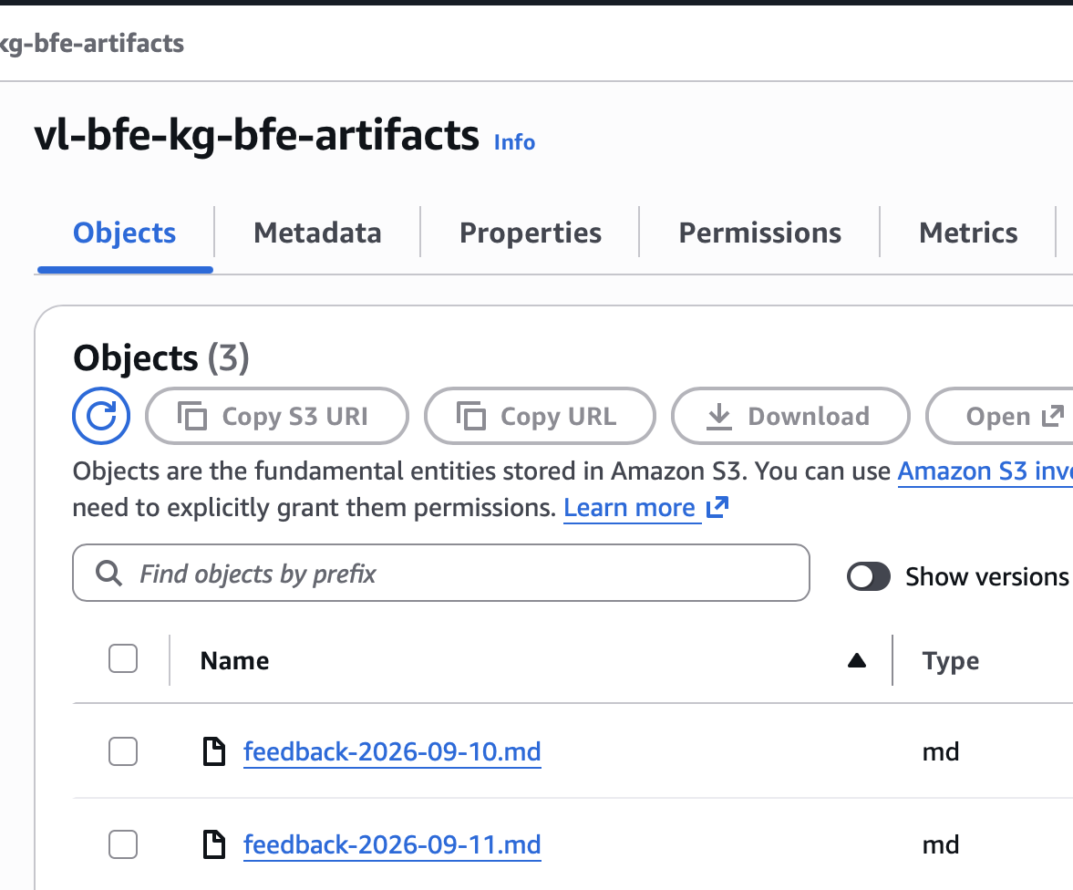
Tool calls in real time
— “What are Switzerland's renewable electricity targets?”
Feedback tool call

Slide 10



Governance & Operating Model
— Six recommendations — and what each one rests on
1 · Ownership
The office owns the documents. One editor owns the graph. Anyone proposes, nobody commits. Every fact carries reason, source, author, date.
2 · Freshness
Update on publication, not on a calendar. last_updated per document, graph_version per answer.
3 · Scope
Only what is already published and citable. Deduplicate before exposure. Fix language metadata at the source.
editorial, not infrastructure
stable document ids are mandatory
305 of 2,430 objects are duplicates — 12.6%
4 · Access
Public to read. Authenticated to write or to spend. Anonymous reads are rate-limited; named clients get higher quotas.
5 · Rollout & cost
Prove it internally before promising anything. Internal → named pilots → public with a published p95.
6 · Consumer duties
We supply facts with sources. The application owns the answer. Always cite. Treat "not covered" as an answer. Report wrong answers back.
feedback is a write — it must be attributable
14 s cold / 3.6 s warm — too early for SLA
61 numbers checked · 0 hallucinated · 6 composition defects

Slide 11
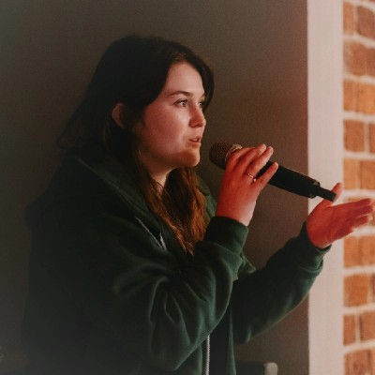

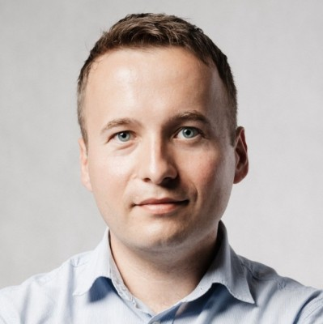

Let’s Talk During Apéro
Kseniia Sych
Tomasz Jażdżewski
Paweł Urba
Grzegorz Król

